Slide 1
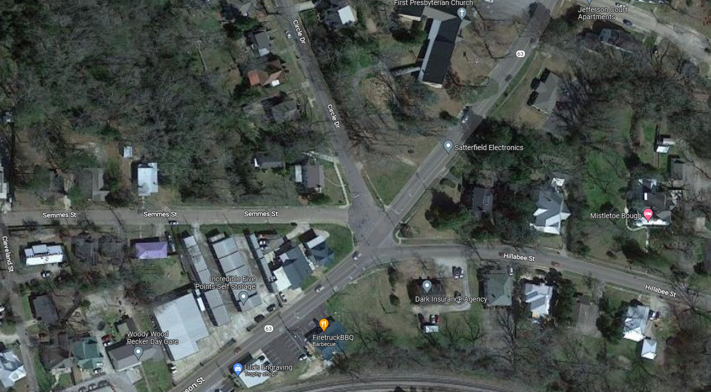
AL 63 @ 5 Points

Slide 2
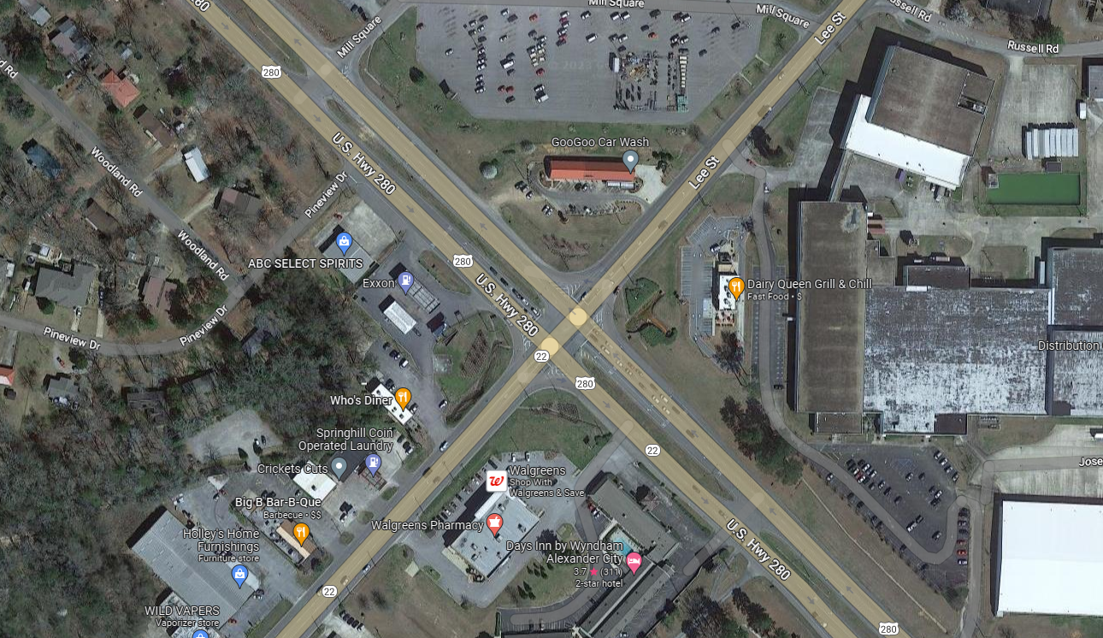
Hwy 22 @ US 280

Slide 3
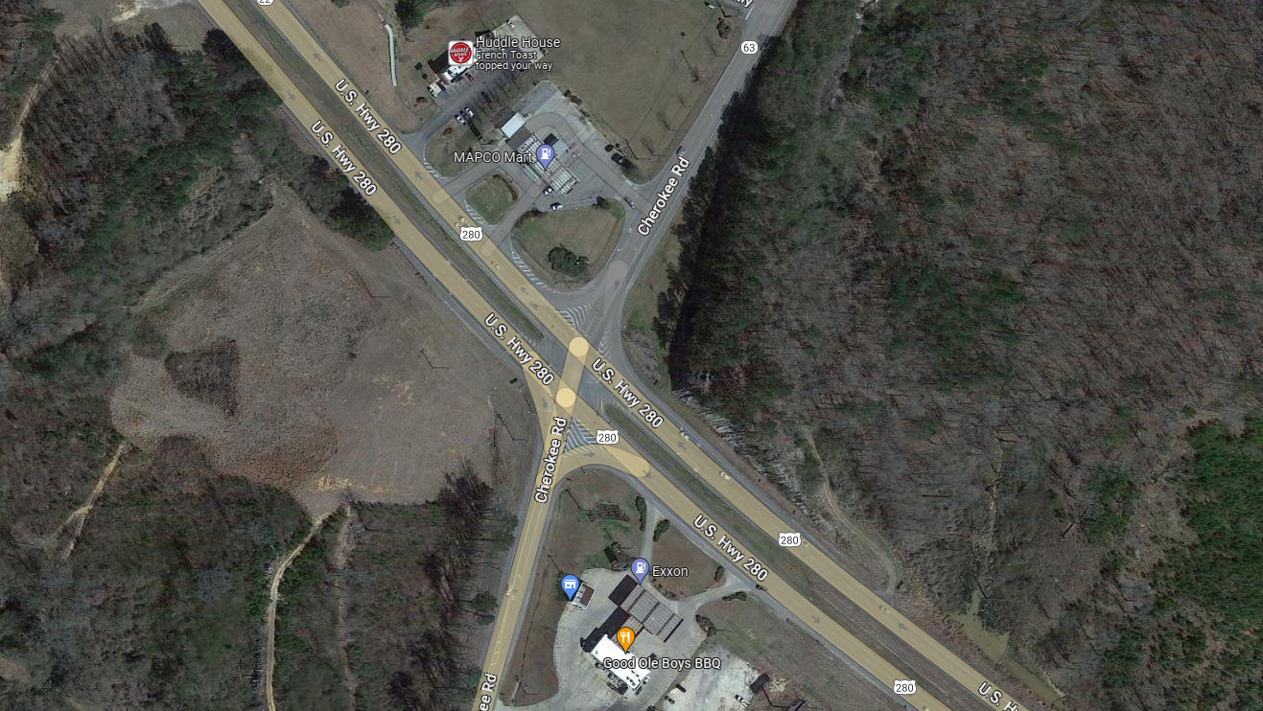
AL 63 @ US 280

Slide 4
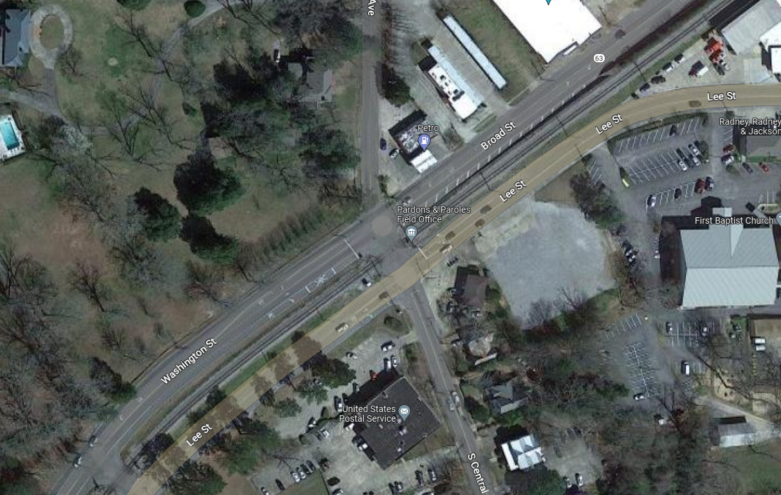
AL 63 @ Post Office

